Slide 1



Slide 2

“America thrived in the 20th century because we made high school free, sent a generation of GI’s to college, and trained the best workforce in the world. But in the 21st century economy that rewards knowledge like never before, we need to do more.”
Barack Obama

Slide 3
What is the College Promise?

Slide 4
America’s College Promise is a nation-wide nonpartisan, local, and state-led higher education initiative to make 2 years of a community college education free for responsible American students. The proposal was inspired by bi-partisan efforts in Tennessee, Chicago, Miami, and Kalamazoo where leaders came together to make good on the Promise.
The College Promise Campaign will work with leaders in education, business, philanthropy, non-profits, and other sectors to create College Promise programs across the country. The idea is already gaining momentum in places like Oregon, Minnesota, Philadelphia, and Long Beach. College Promise programs are growing!

Slide 5
College Promise Campaign Goals
Make 2 years of college as debt-free and universal as high school
Enhance student responsibility and cut cost of college for all Americans
Help build high-quality community colleges
Improve 2-to-4-year institution transfer processes and outcomes
Ensure states share responsibility for educating citizens
Expand technical training for middle-class jobs
Build on local, state, and national programs that support college access, academic persistence, and completion

Slide 6


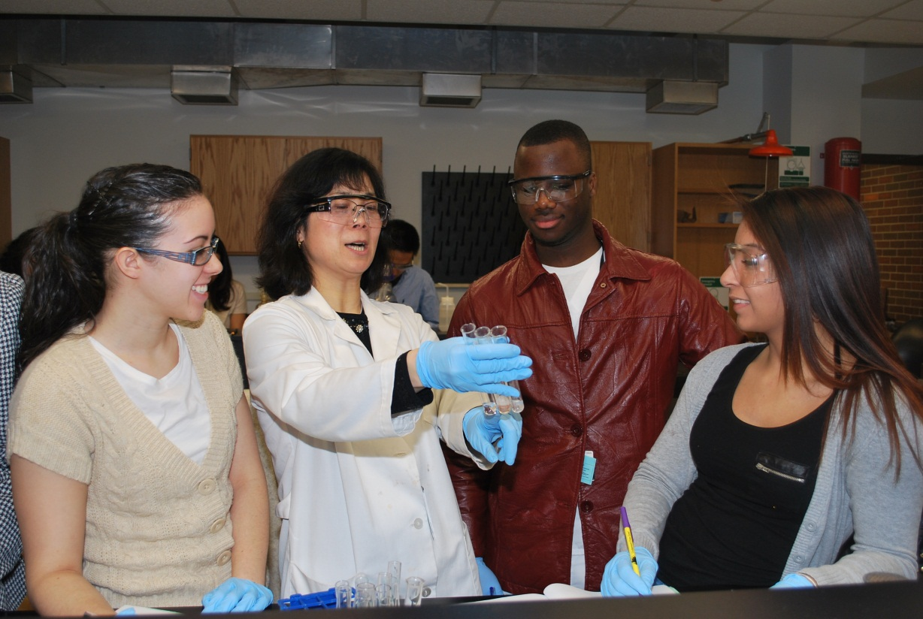

Slide 7

MAKING COMMUNITY COLLEGE FREE FOR ANYONE WILLING TO WORK FOR IT
Work means getting good grades and being serious about getting a degree or certificate.
Credits will transfer to a 4-year university or go towards completing vocational certificates and degrees.
Local, state, and federal governments work together to pay for this.

Slide 8

HOW DO WE BEGIN?

Slide 9

The campaign will launch a national public awareness campaign that promotes and emphasizes community college completion by:
Encouraging community, regional, and state stakeholders to incorporate proven methods that work
Leveraging the results of evidence-based research to support investing in the College Promise
Implementing outreach, field-building, communications , and publication plans

Slide 10
Long Term…..
Over a 3-year period, promoting public policy development at the local and state levels to increase College Promise programs benefiting community college students
Implementing a national communications and digital media plan to evaluate students, families, and policy leaders
Engage in field-building in 11 states to galvanize local and state leaders to take action
Continue to build the campaign to include 20 additional states in the second phase of the campaign
Showcase College Promise models and strategies to increase college access and completion

Slide 11


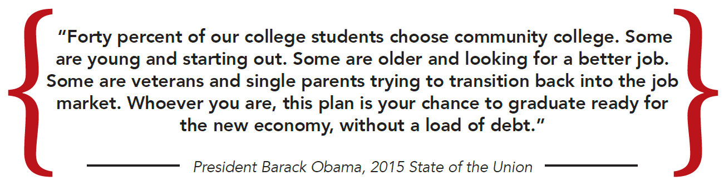
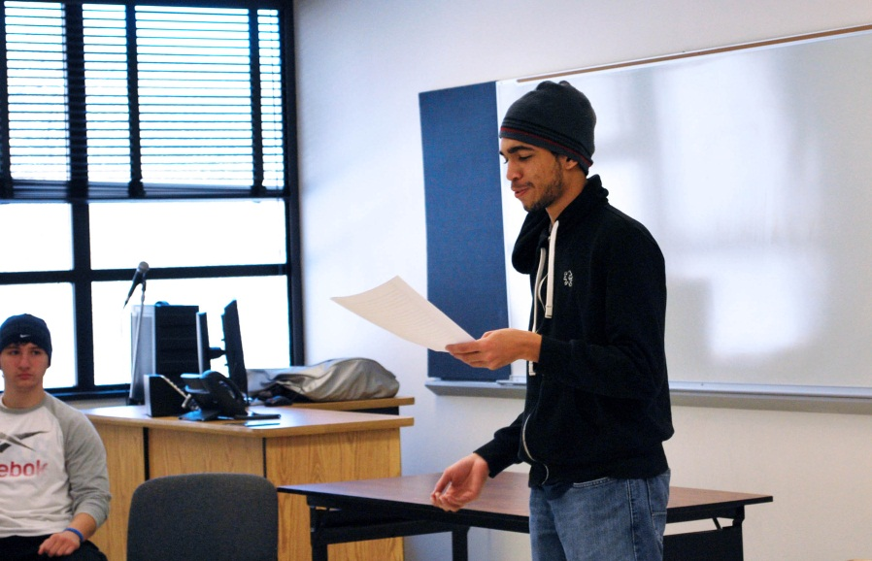


Slide 12


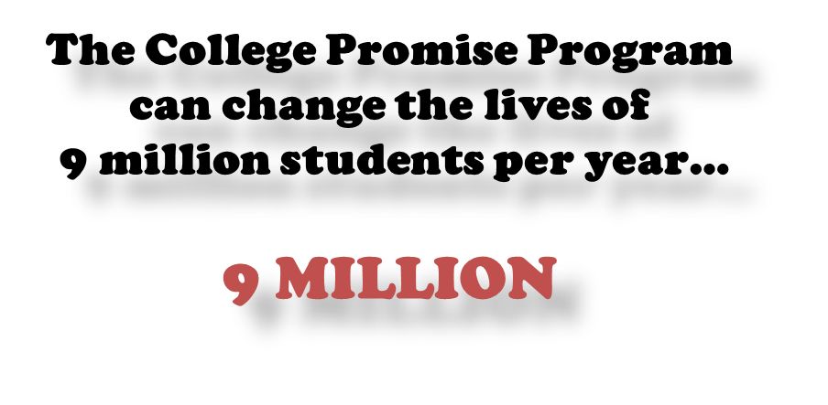


Slide 13
FAQs
The following frequently asked questions are provided by Civic Nation. Please visit civic nation.org for more information.
What is the College Promise Campaign?
In the 21st century, a high school diploma is no longer enough to lead Americans to a good job and decent quality of life. The College Promise Campaign (CPC or the Campaign) is a national, nonpartisan, local and state-led higher education initiative—beginning in America’s community colleges. The Campaign will build widespread support for a free community college education for all responsible students and broad public understanding that a free community college education is an investment in America’s future and a necessary continuation of K-12 education.
What is Civic Nation and why is the College Promise Campaign being spearheaded by this organization?
Civic nation is a charitable and educational 501(c)(3) organization. Founded in 2015, Civic nation is organized to promote sensible policies to challenges in the areas of federal, state, and local policy. Civic nation educates the public about such policies, about public policy issues arising in these areas, and for related purposes. Further, Civic nation is the legal entity that houses and supports the infrastructure for the College Promise Campaign. no federal or state lobbying is conducted by Civic nation on behalf of the College Promise Campaign

Slide 14


