Slide 1
Records Retention and Disposition
Naugatuck Valley Community College
April 27, 2012
Presented by the Office of the Public Records Administrator
© 2012 Connecticut State Library

Slide 2
Presenters
LeAnn Power, Public Records Administrator
Lizette Pelletier, Public Records Archivist

Slide 3
Agenda
Authority for Records Management Program
Your Responsibilities
Common Definitions
Records Retention
Records Disposition

Slide 4
Records Management
in Connecticut
The Connecticut State Library is the public records office for the State of Connecticut
Connecticut General Statutes §11-8 and §11-8a grants authority for this program to the Connecticut State Library, Office of the Public Records Administrator

Slide 5
Statutory Responsibilities:
Agency
Designate an agency employee to serve as Records Management Liaison Officer (RMLO)
Inventory records
Establish records retention schedules and keep them up-to-date
Transfer historical records to the State Archives or destroy records after receiving written approval
(Pursuant to CGS §11-8a)

Slide 6
Statutory Responsibilities:
Employee
Retaining records until they are eligible for disposition
Ensuring records are disposed of after receiving authorization
(Pursuant to CGS §11-8b, §7-109, §1-240, and §53-153)

Slide 7
Public Record:
“Any recorded data or information relating to the conduct of the public’s business prepared, owned, used, received or retained by a public agency, or to which a public agency is entitled to receive a copy by law or contract under section 1-218, whether such data or information be handwritten, typed, tape-recorded, printed, Photostatted, photographed, or recorded by any other method.”
Source: Section 1-200(5) of the General Statutes of Connecticut.

Slide 8
Official Record Copy:
“The original or official copy of a record that is retained for legal, operational, or historical purposes.”
Source: “ARMA International. Glossary of Records and Information Management Terms, 3rd ed. Lenexa, KS: ARMA International, 2007.

Slide 9
Non-record:
“Item that is not usually included within the scope of official records (e.g., convenience file, day file, reference material, and draft)”
Source: “Establishing Alphabetic, Numeric, and Subject Filing Systems” (ANSI/ARMA 12-2005).

Slide 10
Records Management
The field of management responsible for the efficient and systematic control of the creation, receipt, maintenance, use and disposition of records, including processes for capturing and maintaining evidence of and information about business activities and transactions in the form of records.
Source: ARMA International

Slide 11
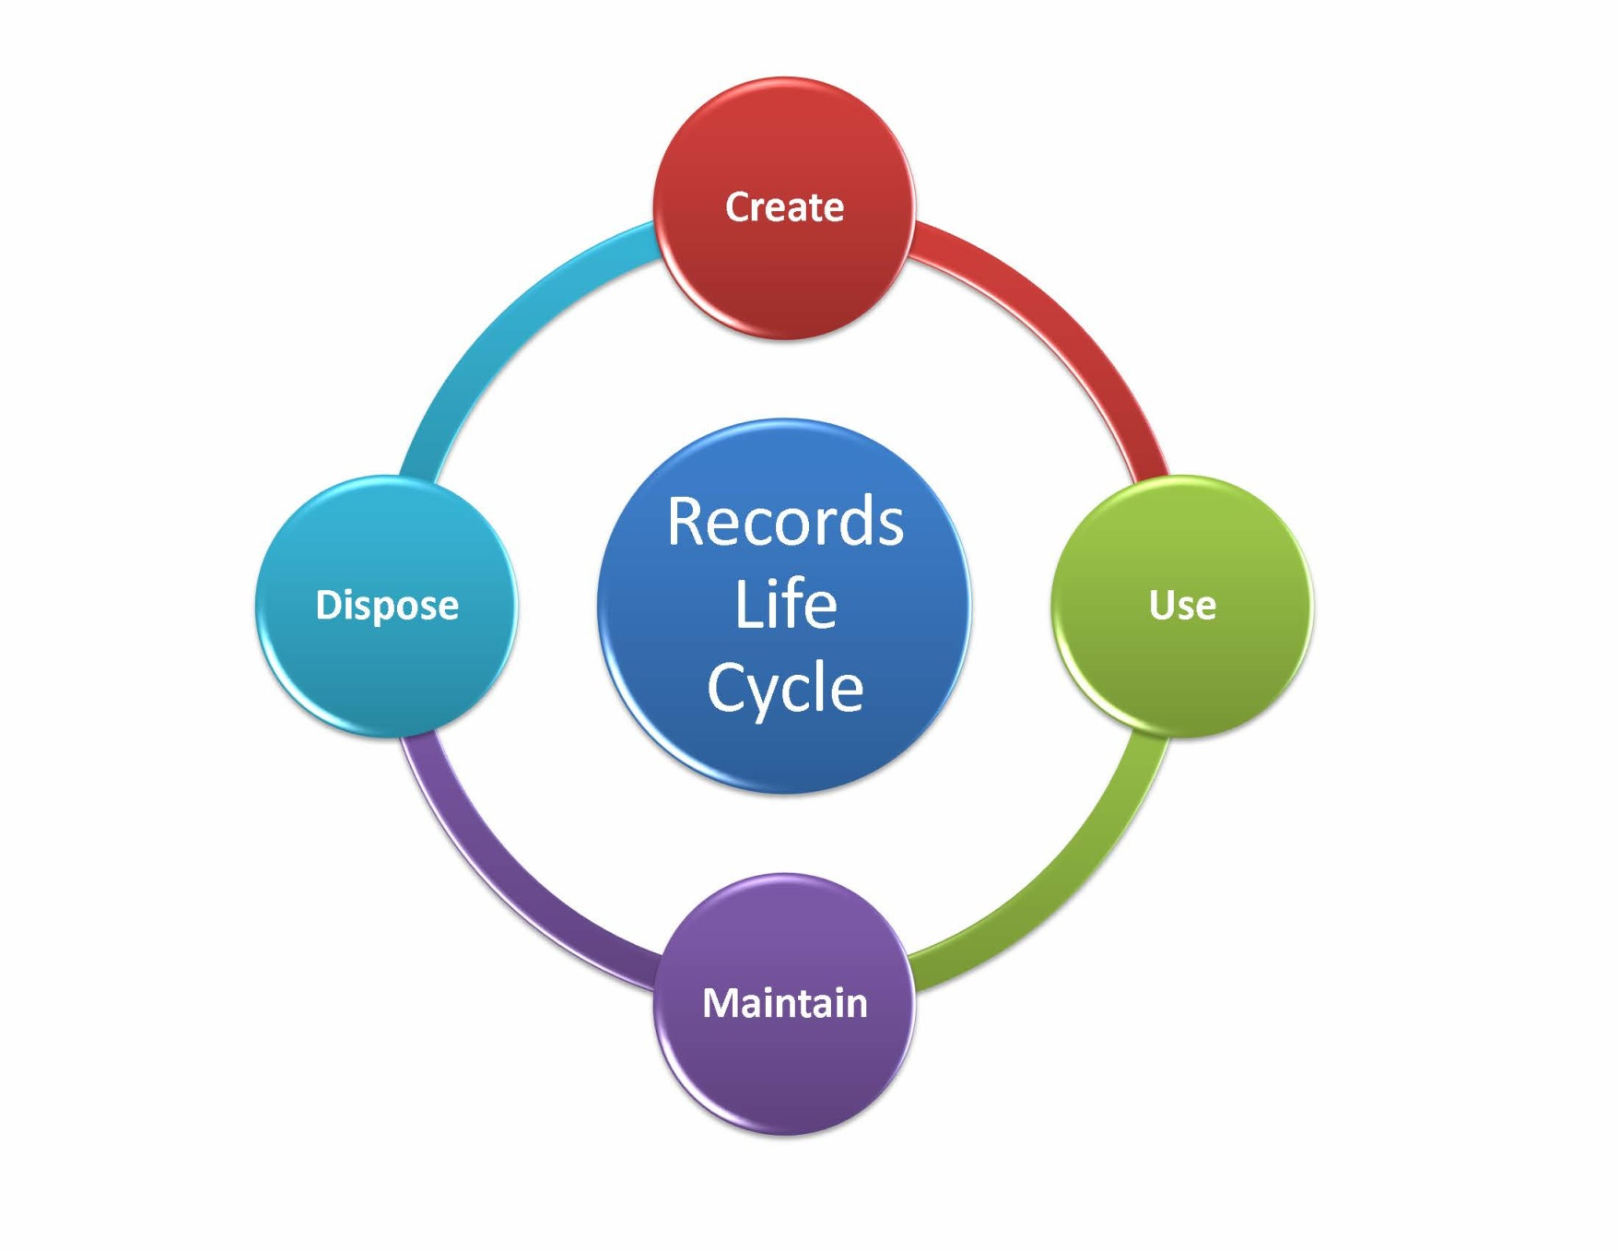
Life-Cycle of Records

Slide 12
Records Analysis and Recordkeeping Requirements (cont.)
Value
  Administrative
  Legal
  Fiscal
  Historical / Research
Audit Requirements
  State or federal fiscal audits
  Other internal audits
Legal Requirements
  Laws and regulations
  Statutes of limitation

Slide 13

Records Analysis and Recordkeeping Requirements
Just In Case*
*Not an acceptable value

Slide 14
Records Retention Schedule:
“A comprehensive list of records series, indicating for each the length of time it is to be maintained and its disposition.”
Source: “Establishing Alphabetic, Numeric, and Subject Filing Systems” (ANSI/ARMA 12-2005).

Slide 15
Records Series:
“A group of similar records that are arranged according to a filing system and that are related as the result of being created, received, or used in the same activity.”
Source: “A Glossary of Archival and Records Terminology,” Society of American Archivists, Pearce-Moses, Richard, 2005.

Slide 16
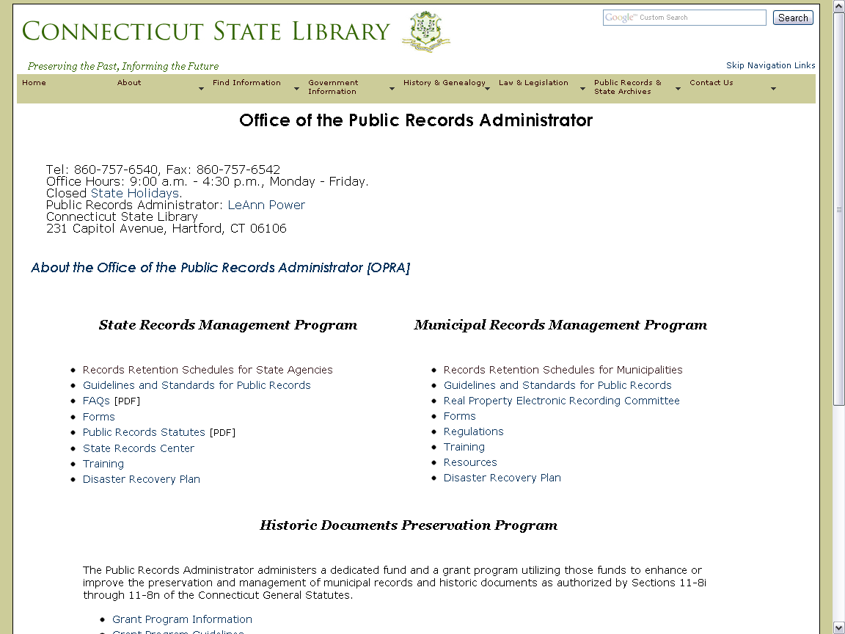
www.cslib.org/publicrecords

Slide 17
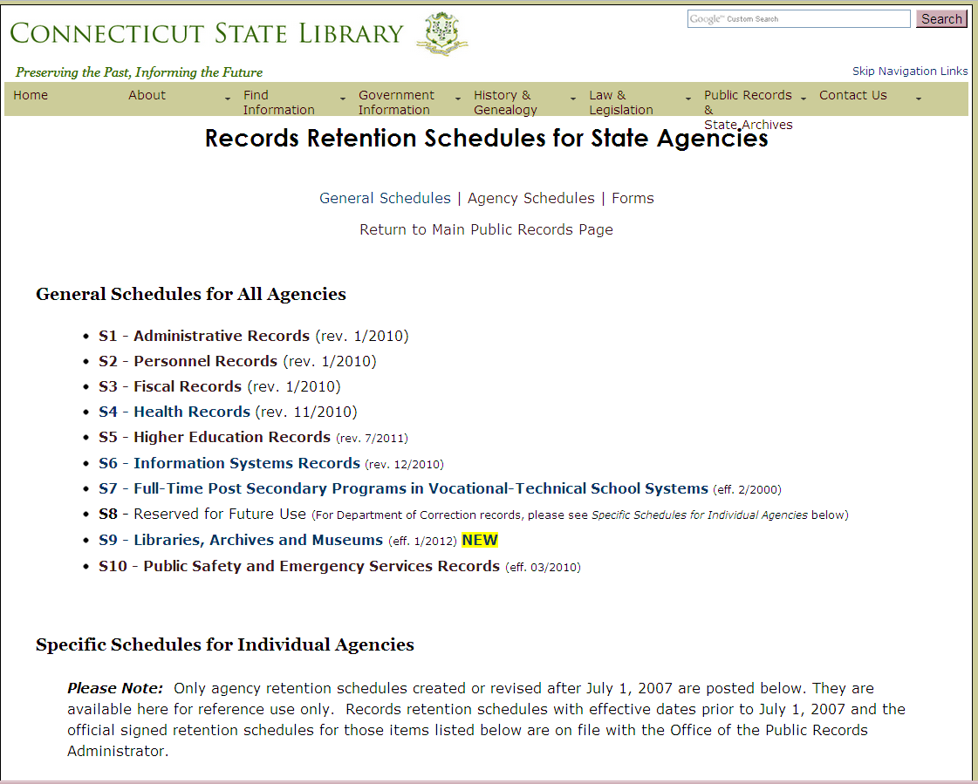

Slide 18
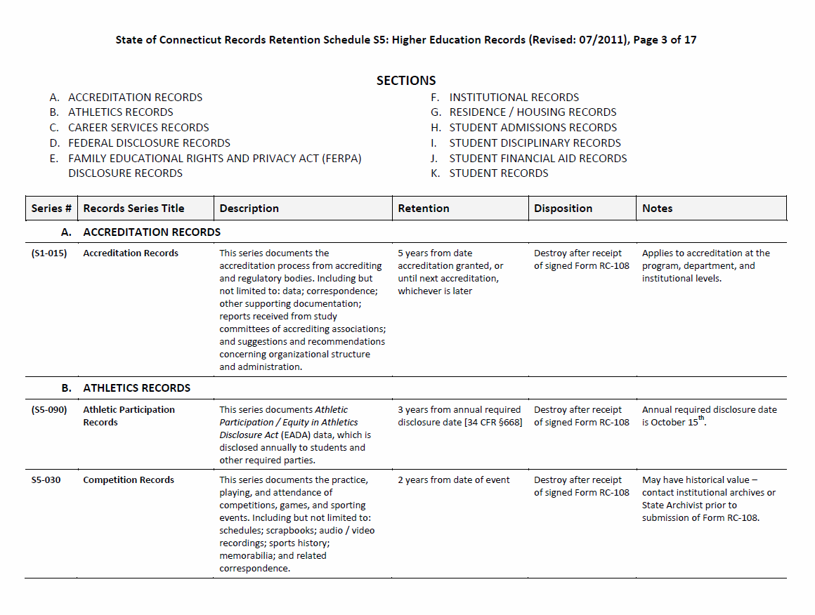

Slide 19
Records Retention
Maintain the record for the retention period
  Retention period is the minimum amount of time
  Some records have maximum retention periods set by federal or state statutes or regulations and must be destroyed at the end of the retention period
Apply disposition to all records once they meet the retention period
If a record does not have a retention period, contact your RMLO

Slide 20
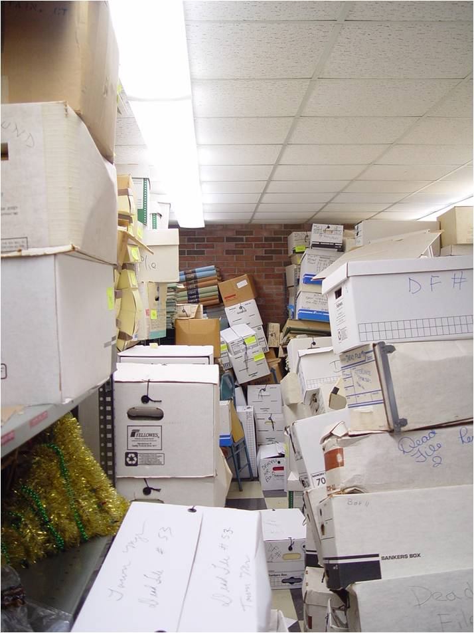

Government Agency Edition

Slide 21
Applied Retention Schedule Results
30% of your records can be destroyed
40% of your records will remain in your office
30% of your records can be transferred to a records center or other repository
Source: ARMA International

Slide 22
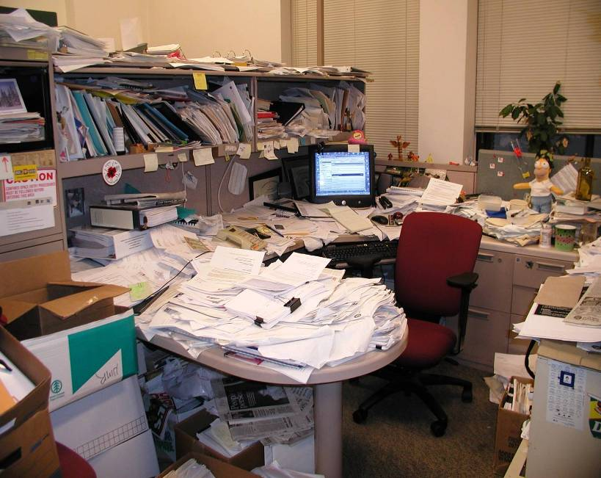
Notes:
22

Slide 23

Notes:
23

Slide 24
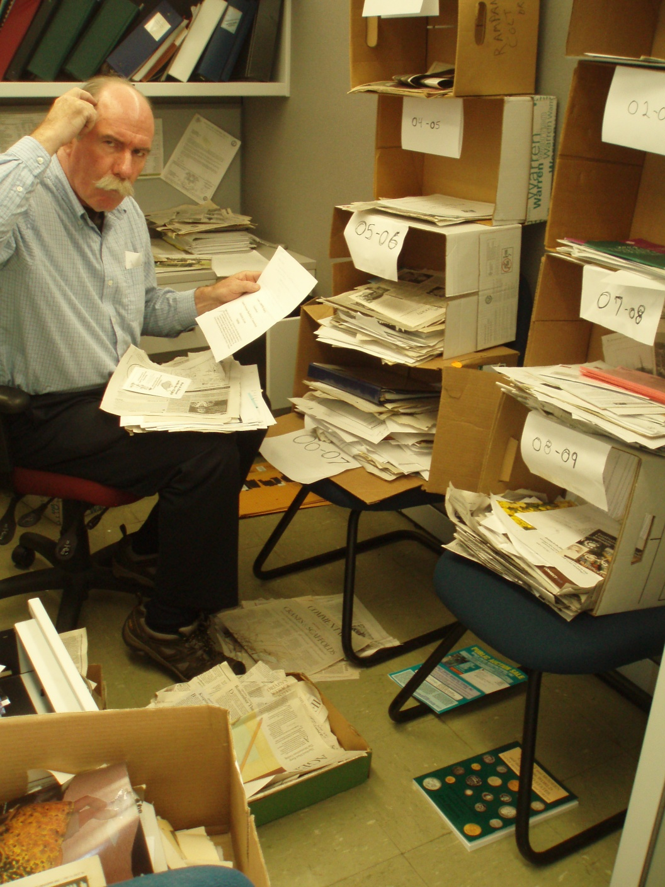

Slide 25
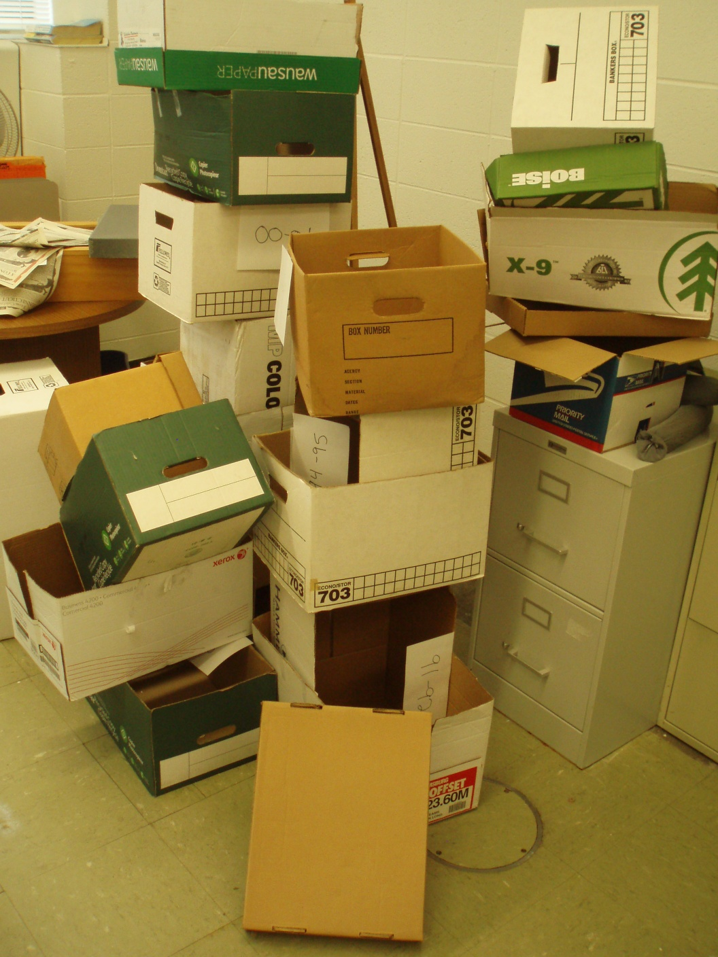

Slide 26
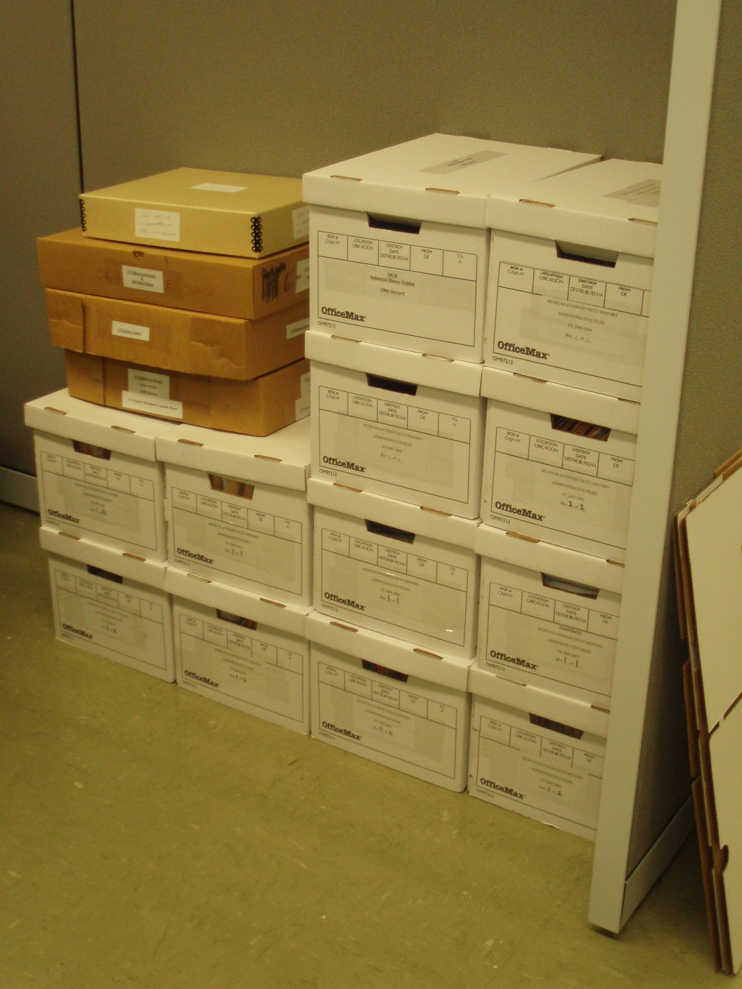

Slide 27
Records Disposition
Disposition of records refers to either:
  Destruction of records
  Transfer of records
Refer to Public Records Policy 5: Disposition of Public Records
Retention schedules do not authorize disposition of records

Slide 28
Records Disposition:
Destruction Holds and Punitive Statutes
Destruction Holds
  Litigation
  FOIA request
  Other pending action
Statutes: Criminal Intent
  CGS §1-240
  CGS §53-153

Slide 29
Records Disposition:
Education Records
Definition
  Records directly related to a student
  Maintained by an educational agency or institution or by a party acting for the agency or institution.
  Source: 20 USG §1232(g) and 34 CFR §99
Federal Laws
  Family Educational Rights and Privacy Act (FERPA)
  Individuals with Disabilities Education Act (IDEA)

Slide 30
Proper Records Disposition
Protection from sanctions under FOIA or litigation
Demonstrate records management is ongoing and established function
  Adhere to the schedules and disposition procedures
  Follow established guidelines and standards
  Establish a litigation hold procedure

Slide 31
Destruction of Records
Obtain authorization to destroy public records by submitting a Records Disposition Authorization (Form RC-108)
Destroy records
Method of destruction is dependent on the format:
  Hard copy
  Electronic media

Slide 32
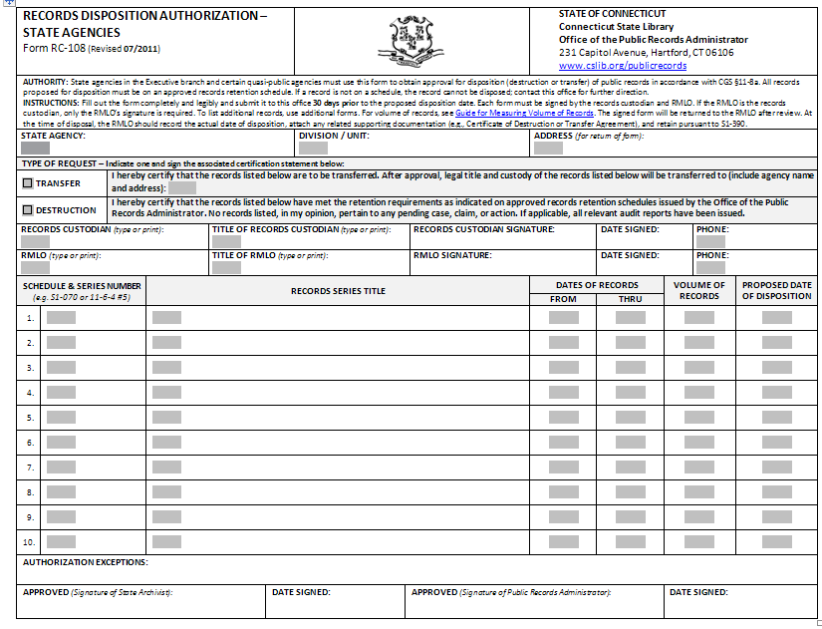

Slide 33
Transfer of Records
Obtain authorization to transfer public records by submitting a Records Disposition Authorization (Form RC-108)
Applies to:
  Reorganizations, consolidations, and mergers Refer to Public Records Policy 6: Retention of Records for Agency Closures, Mergers, and Consolidations
  Transferring records to the State Archives or another approved archival repository
  Refer to General Letter 2009-1: Transfer of Records to the State Archives

Slide 34
Managing Electronic Records
Connecticut Uniform Electronic Transactions Act (CUETA), CGS §1-266 thru 286
  Defines “electronic record”
  Gives electronic records equal legal standing to paper records
The same records management principles apply to electronic records as paper records
The content of the record determines whether or not it is a record, what records series it belongs to, and how long it should be retained

Slide 35
Managing Electronic Records:
Challenges and Issues
Software dependency
Limitations to the life of media
Data migration
Distribution
Security
Sustainability

Slide 36
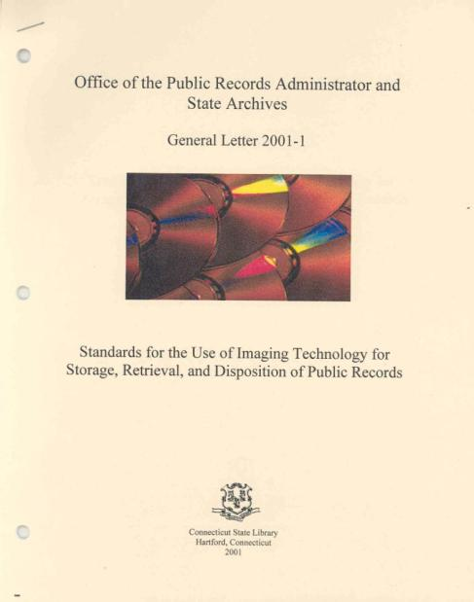
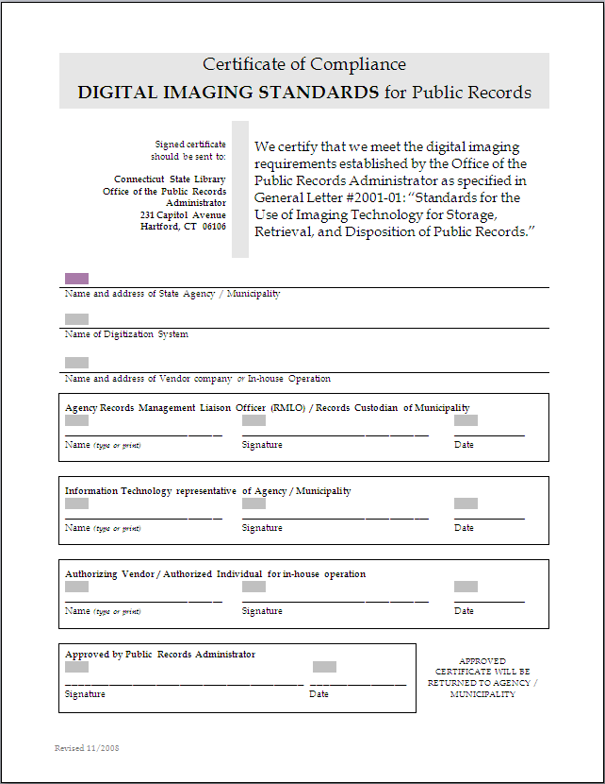
Optical Imaging Technology (Scanning)
General Letter 2001-1
Disposition Authorizations
  Records with a retention period of 10 years or less that are reformatted by scanning
  Records with a retention period greater than 10 years must have an approved human readable back-up

Slide 37
Managing Email:
Policies
GL #2009-2 Management and Retention of E‐mail and other Electronic Messages
State of Connecticut Records Retention Schedule S1: Administrative Records
  State Department of Administrative Services Acceptable Use of State Systems Policy
www.ct.gov/best/cwp/view.asp?a=1245&Q=314686

Slide 38
Managing Email:
Retention
E-mail is a type of correspondence
Retention categories
  S1-060 Transitory No requirement
  S1-070 Routine 2 years
  S1-080 Other Follow retention of equivalent
  series

Slide 39
Managing E-mail:
Individual Best Practices
E-mail systems are not designed to be filing systems
Follow policies and procedures
Follow best practices for writing and sending e-mail
Don’t let transitory e-mail accumulate
Don’t forget to manage “sent” mail
Utilize functions in your e-mail system to tag and categorize e-mail

Slide 40
Removal of Personal Data
Pursuant to CGS §4-193(e), agencies “shall maintain information about a person which is relevant and necessary to accomplish the lawful purposes of the agency”
The destruction of public records, including public employee discipline records, is an illegal subject of collective bargaining agreements (Lieberman v. Board of Labor Relations)
Request for Removal of Public Records Personal Data Files (Form RC-077)

Slide 41

Office of the Public Records Administrator
231 Capitol Avenue
Hartford, CT 06106
www.cslib.org
LeAnn Power, CRM
Public Records Administrator
LeAnn.Power@ct.gov
(860) 757-6540
Lizette Pelletier
Public Records Archivist
Lizette.Pelletier@ct.gov
(860) 566-1100 ext. 304

